Slide 1
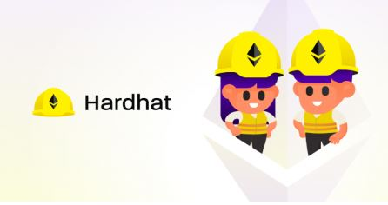
Interacting with Smart Contract using Hardhat
Lect 9

Slide 2
Introduction to Ether.js (Ethereum JavaScript API)
The ethers.js library aims to be a complete and compact library for interacting with the Ethereum Blockchain and its ecosystem.
Ethers.js is a lightweight javascript library which can be used as an alternative to Web3.js to build frontend.
It was originally designed for use with ethers.io and has since expanded into a more general-purpose library.

Slide 3
To play with Ethers.js, there are Tools Needed
Console: Node console, Truffle console, Hardhat console
Front-end framework: React / Next.js / Web3-React
Blockchain Providers: Infura, Alchemy, Metamask Provider
Wallet: MetaMask(Browser Extension Wallet)

Slide 4
The relationship between Ethers.js and Blockchain
Ethers.js JavaScript API
Provider + RPC Endpoint
Blockchain Network
Provider: A Provider is an abstraction of a connection to the Ethereum network, providing a concise, consistent interface to standard Ethereum node functionality.

Slide 5
To play with ethereum blockchain with the help of Ethers.js
Get Ethers.js Instance
Connect to Provider
Play with it

Slide 6
References:
A beginner’s guide: 4 ways to play with `Ethers.js`
Understanding Blockchain with `Ethers.js`: 4 Tasks of Basics and Transfer
Understanding Blockchain with `Ethers.js`: 4 Tasks of wallet
Understanding Blockchain with `ethers.js`: 4 Tasks of interacting with smart contract
Understanding Blockchain with `Ethers.js`: 4 Tasks of Smart Contract Events

Slide 7
Hardhat
Hardhat is a development environment for Ethereum Blockchain.
Components for editing, compiling, debugging and deploying your smart contracts.
It helps coders and developers to manage many of the tasks that are inherent to developing dApps and smart contracts.
Along with providing developers with the proper tools to manage this process, Hardhat also helps automate some of these steps and provides developers with new, helpful functions.

Slide 8
Hardhat comes with a pre-built local Ethereum network designed with development at its core.
This network focuses on Solidity debugging and features stack traces, messages when transactions of the dApps fail, etc.
The environment is characterized by plugins which a lot of the functionality originates from.
This means that the developers can choose exactly which plugins they would like to include in their development process.
However, it comes with built-in defaults, but they can all be overridden.

Slide 9
Hardhat Runner
Hardhat Runner is the command-line interface (CLI) command used to interact with Hardhat.
This is a task runner, and that provides the users with many different options and alternatives.
The design of the task runner revolves around plugins and tasks.
This further means that every time a developer runs Hardhat from the CLI, they run a task. An example here would be:
Running this command would start the built-in compile task.
It is also possible for Hardhat users to override tasks that already exist, meaning that the workflows are extendable and customizable.

Slide 10
Hardhat Network
This is a local Ethereum network that allows for Hardhat Ethereum development.
This will enable developers to test, run, debug, and deploy the code and their written contracts.

Slide 11
Automatic Error Messages
As the network has the ability to always know what transactions or calls fail and why they are unsuccessful, it utilizes this information to make the debugging process a lot easier.
When a transaction fails without a known reason, the network will provide the users with a clear message explaining the error.
Here are some examples of cases where the network will display an error message to help with the debugging process:
When someone sends ETH to a contract without a receive function or a payable fallback
Calling a function without the right parameters

Slide 12
Calling an external function on a non-contract account
Trying to send an insufficient amount of ETH
Calling a precompiled contract incorrectly
Trying to deploy contracts on the network that exceeds the bitcode size limit

Slide 13
How to Install Hardhat
Create an empty folder (On your system)
Command prompt (Open in new created empty folder) : npm install –save-dev hardhat
Command prompt (They will give you project Skeleton) : npx hardhat

Slide 14
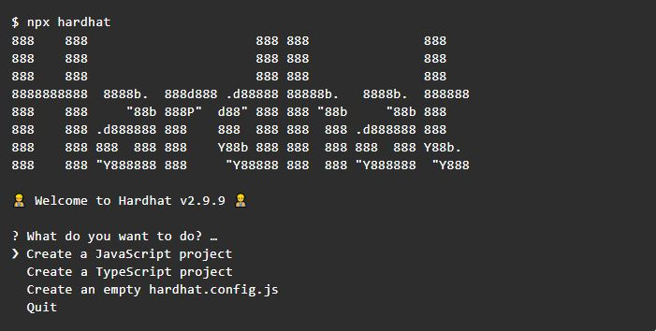
//Select: Create a JavaScript Project

Slide 15
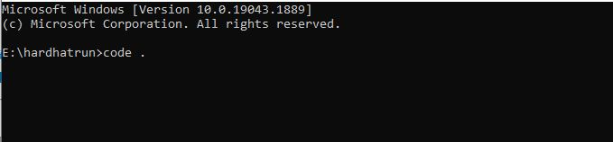
Command Prompt (To make Hardhat compatible with tests built with waffle): npm install --save-dev @nomiclabs/hardhat-waffle ethereum-waffle chai @nomiclabs/hardhat-ethers ethers
Command Prompt (Install dotenv): npm install dotenv
Load the Project in Editor

Slide 16
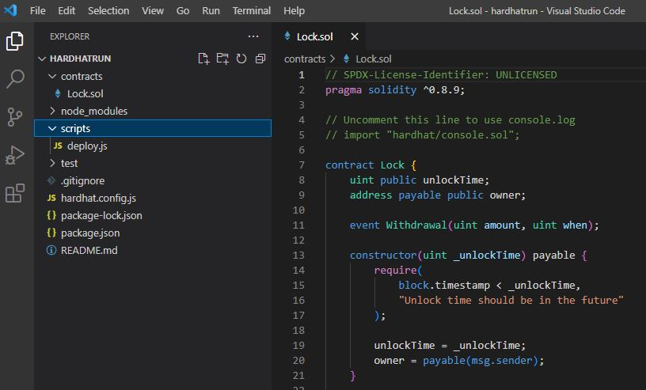
Write .sol and deployment .js files

Slide 17
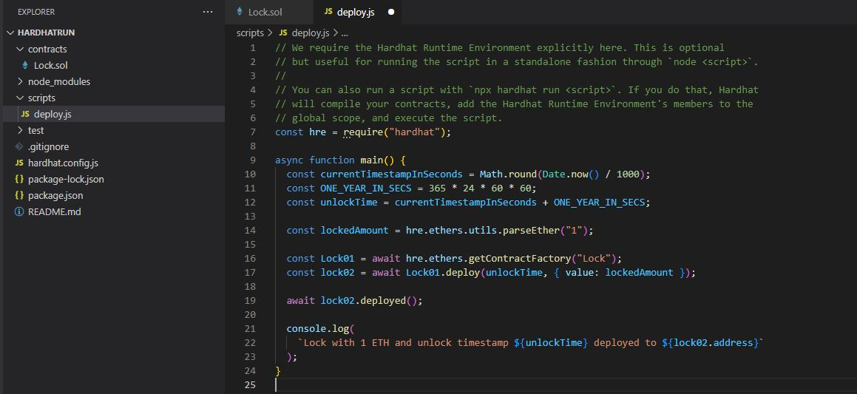
//Name of the Contract

Slide 18
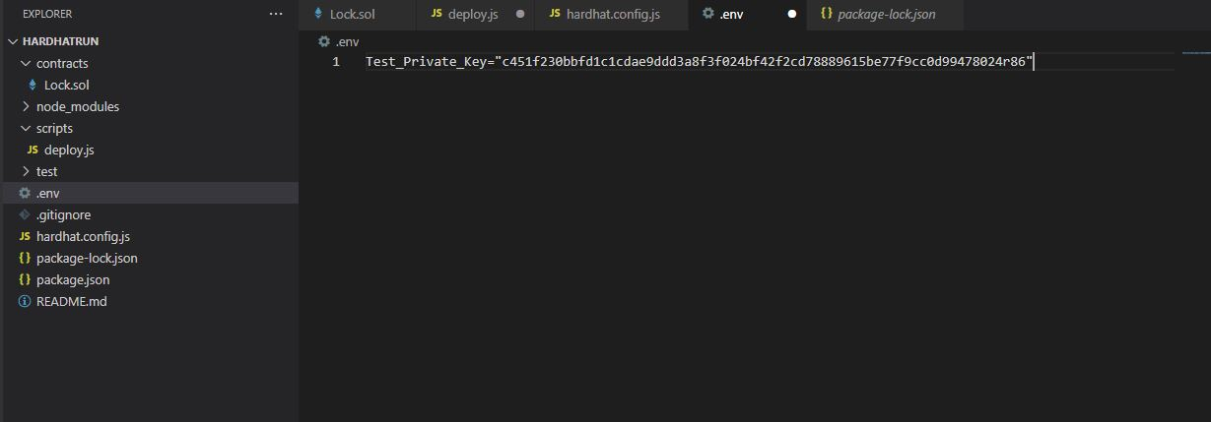
Update hardhat.config.js
Step 1
//Adding Private Key of your wallet
//Create .env File

Slide 19
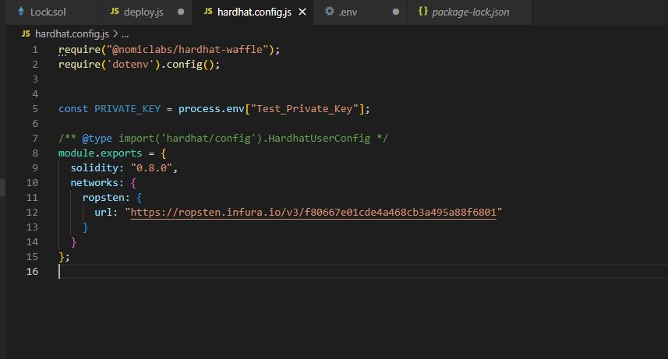
Step 2
//Step 1: Adding hardhat-waffle
//Step 2: Adding dotenv
//Step 3: Adding Test_Private_Key
//Step 4: Adding Network Name and URL

Slide 20
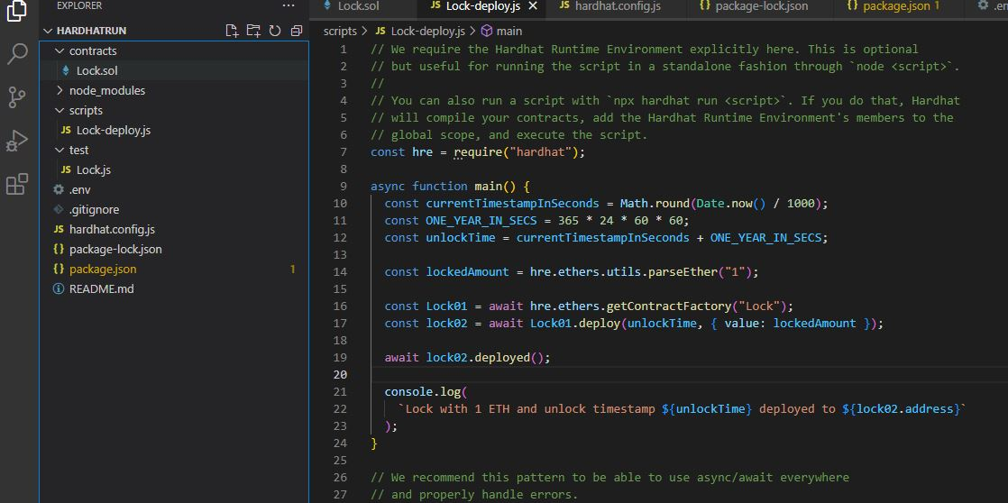
Command Prompt: npx hardhat run --network ropsten scripts/Lock-deploy.js
Now we can Interact with EtherScan
//File Name, which we want to deploy

Slide 21
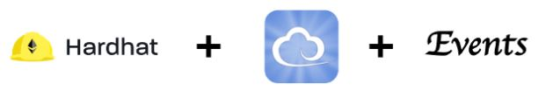
Listening to Events in Hardhat using Ethers.js
This tutorial will help you with listening to Solidity smart contract events.

Slide 22
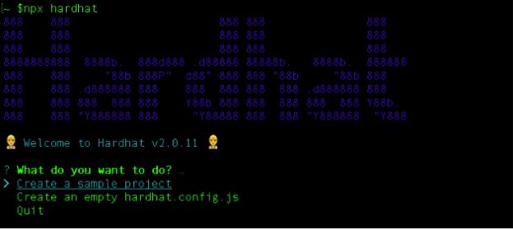
Step 1) Create a Hardhat Sample project with the following command
npx hardhat
To make life easy I will use the sample project provided by Hardhat for demonstrating events.
Hopefully you can later use this example to add and listen to an event in your smart contract.

Slide 23
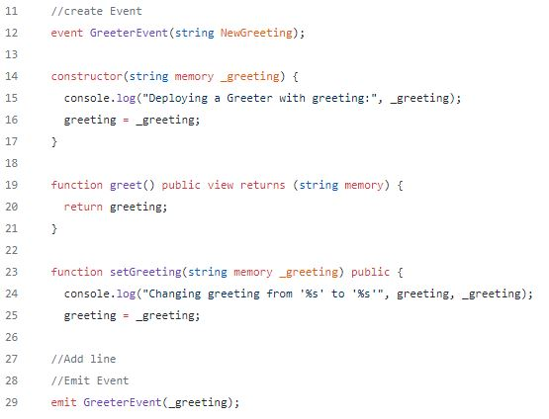
Step 2) Add an event to the contract

Slide 24
We create an event named GreeterEvent() to log any change in the greeting message.
Step 3) Open a new terminal and start a Hardhat network on localhost
npx hardhat node
Step 4) Open another terminal and deploy your contract. The sample deploy script is already there for you
npx hardhat run --network localhost scripts/sample-script.js

Slide 25
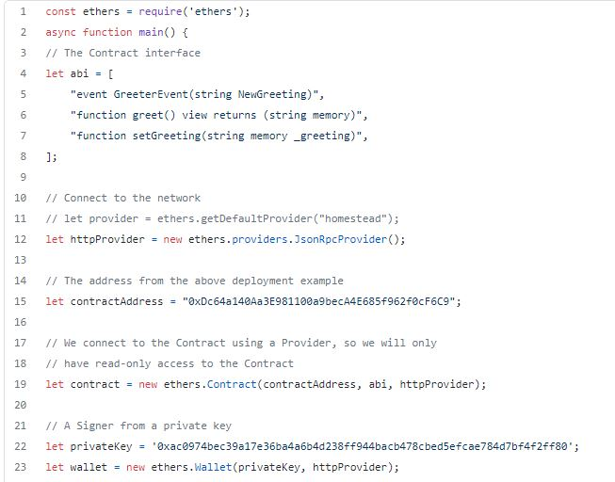
Step 5) The main step — Connect with your smart contract and listen to events

Slide 26
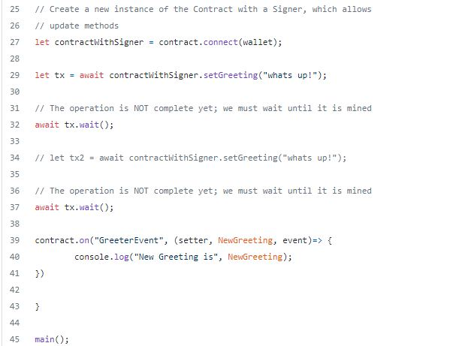

Slide 27
Create a new file event.js in scripts folder as shown above.
The ABI is so much more readable and easy to understand than the provided standard.
Create a tool for converting contract code to the above ABI format.
Make sure to add your contract address
let contractAddress = "your contract address";

Slide 28

Step 6) Run the script
npx hardhat run --network localhost scripts/event.js
Finally!

Slide 29
Adding Filter to our event
To Filter the parameter we have to add the indexed keyword before the argument

Slide 30
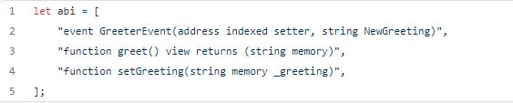
Deploy the contract
npx hardhat run --network localhost scripts/sample-script.js
In event.js make changes to the ABI

Slide 31
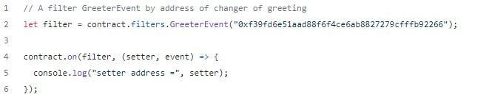
Add the following lines to the end
Now you can filter the event as per the address of the greeting setter.
Hope this becomes a quick snippet for event listening.

Slide 32
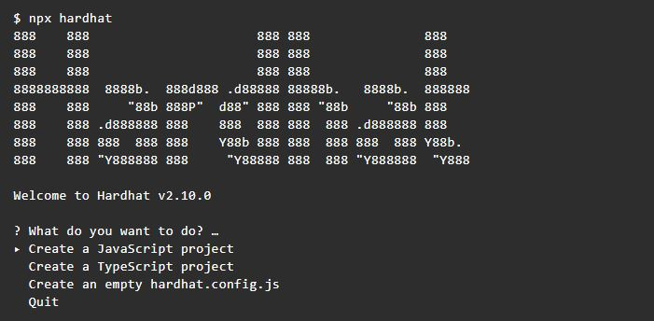
Testing with ethers.js & Waffle
Step 1: Install Hardhat: npx hardhat
//Create an empty hardhat.config.js

Slide 33
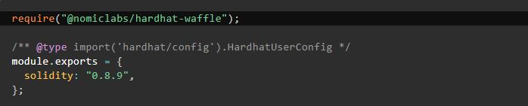
Step 2:
Step 3: Then open the hardhat.config.js file and require the plugin:

Slide 34
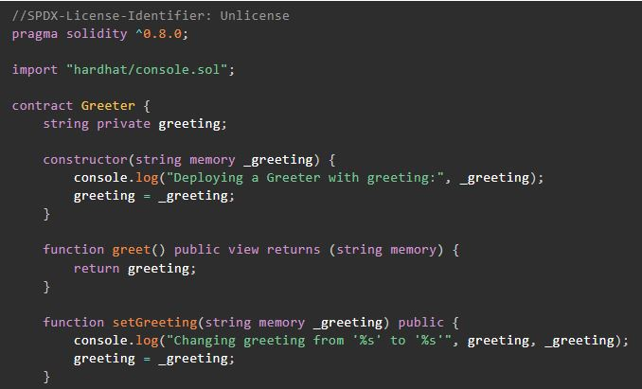
Testing
let's add a simple contract. Create a contracts directory and then add a contracts/Greeter.sol file with this code:

Slide 35
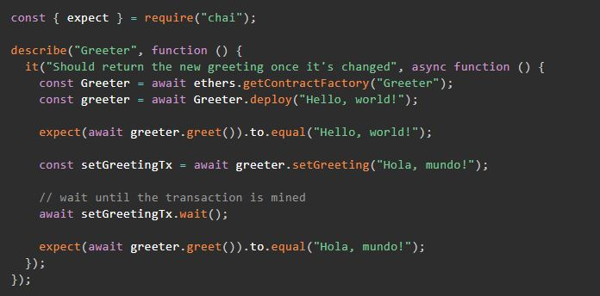
Then create a test folder and add a test/test.js file:

Slide 36
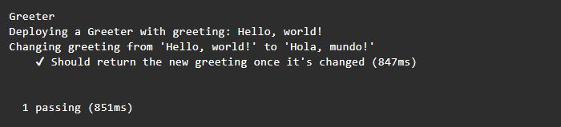
In your terminal, run npx hardhat test. You should see the following output:

Slide 37
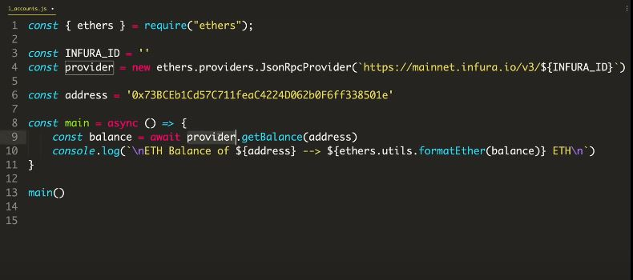
For Checking Account Balance account.js
//Infura Id

Slide 38
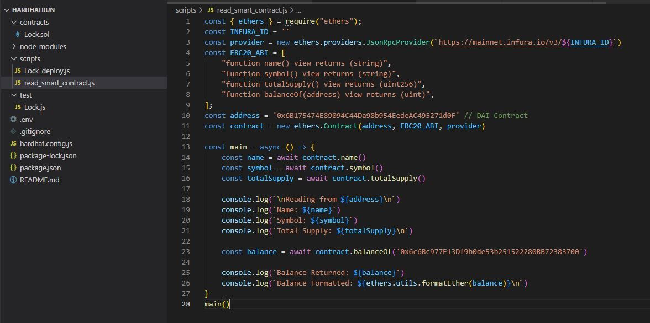
For Reading Smart Contract read_smart_contract.js
//abi

Slide 39
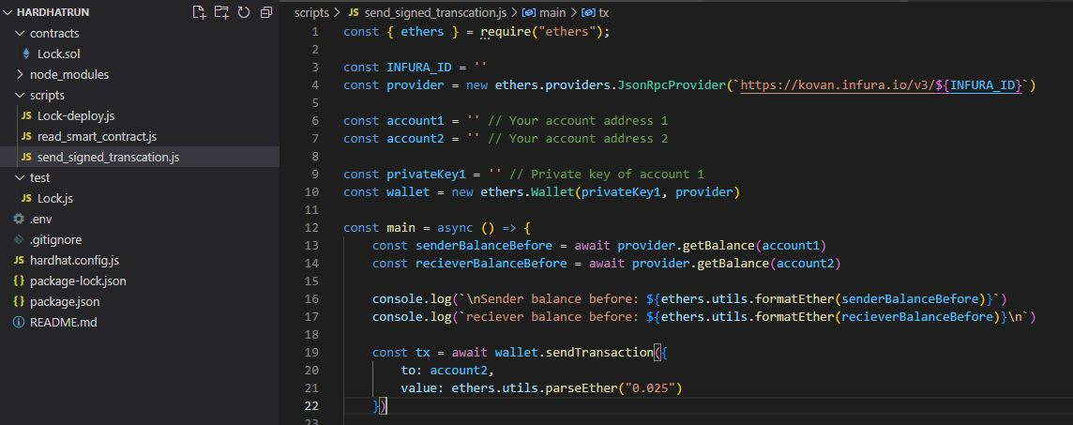
For Sending Balance send_signed_sranscation.js
//Private Account Key

Slide 40
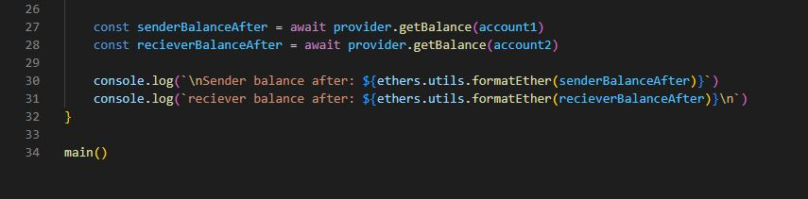

Slide 41
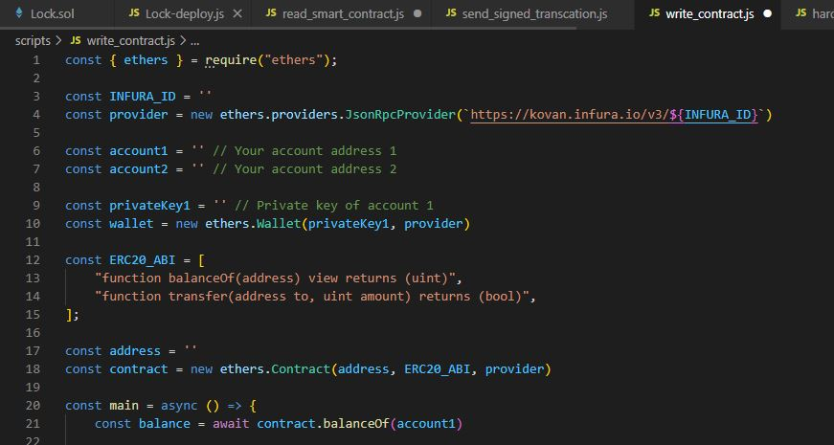
WriteContract.js

Slide 42
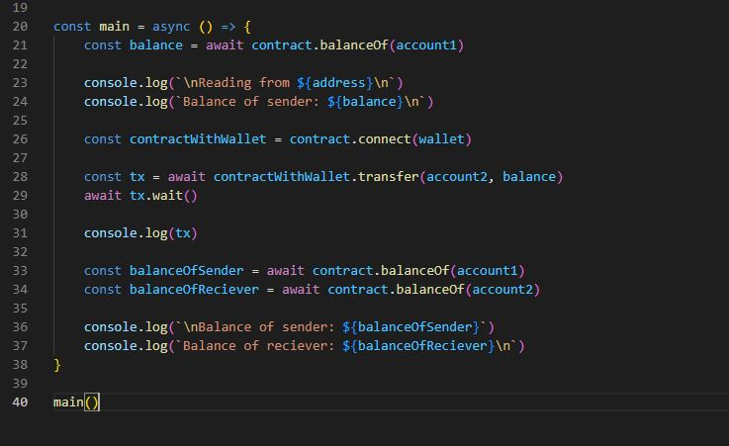

Slide 43
Finished
Thankyou for your Attention!

